Slide 1
Rhythm Analysis in Music
EECS 352: Machine Perception of Music & Audio

Slide 2
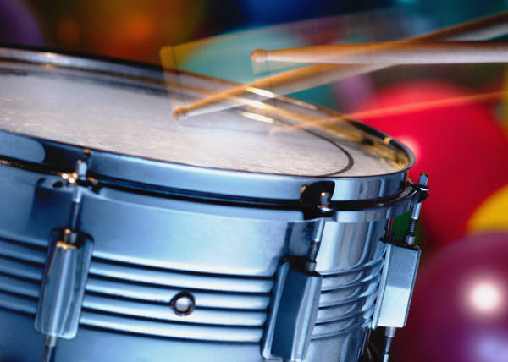
Some Definitions
Rhythm
“movement marked by the regulated succession of strong and weak elements, or of opposite or different conditions.” [OED]

Slide 3
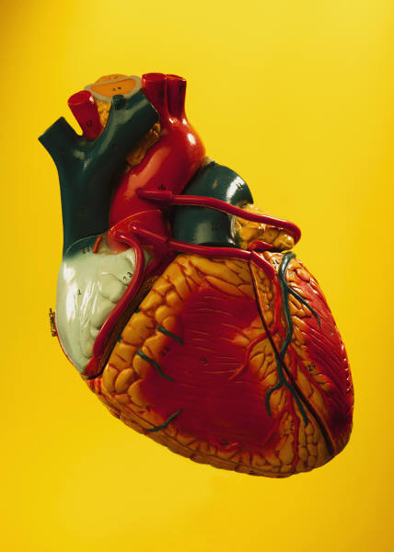
Some Definitions
Beat
Basic unit of time in music

Slide 4
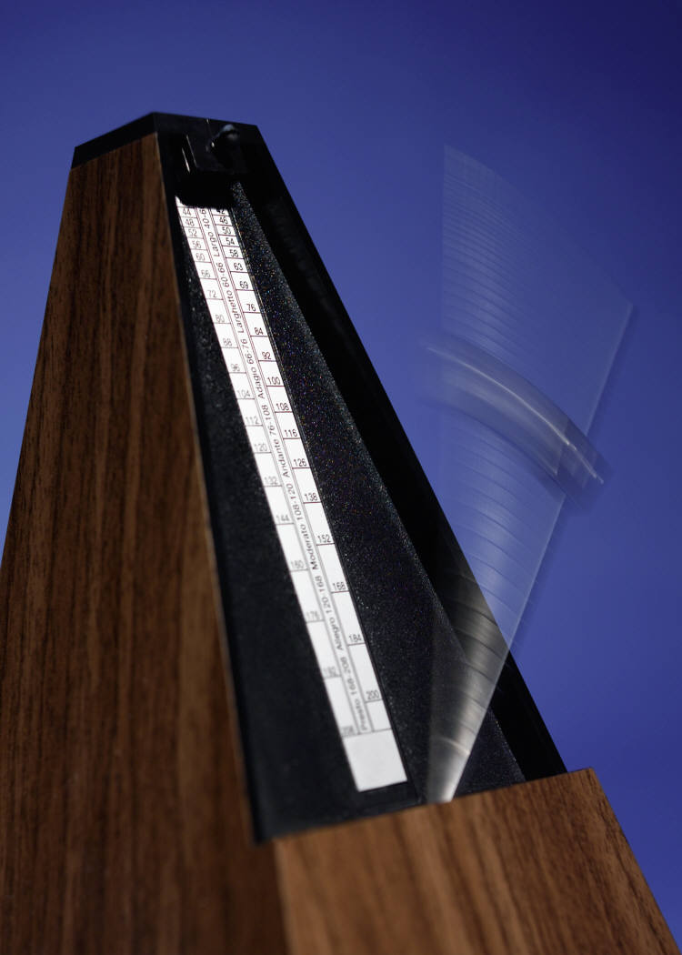
Some Definitions
Tempo
Speed or pace of a given piece, typically measured in beats per minute (BPM)

Slide 5
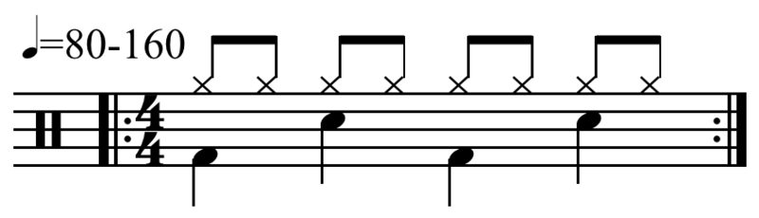

Some Definitions
Bar (or measure)
Segment of time defined by a given number of beats
A 4-beat measure drum pattern.
[http://en.wikipedia.org/wiki/Metre_(music)]

Slide 6
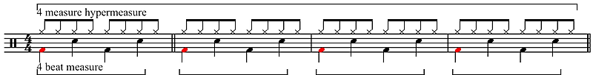
Some Definitions
Meter (or metre)
Organization of music into regularly recurring measures of stressed and unstressed beats
Hypermeter: 4-beat measure and 4-measure hypermeasure. Hyperbeats in red.
[http://en.wikipedia.org/wiki/Metre_(music)]

Slide 7

Some Applications
Onset detection
Tempo estimation
Beat tracking
Higher-level structures

Slide 8
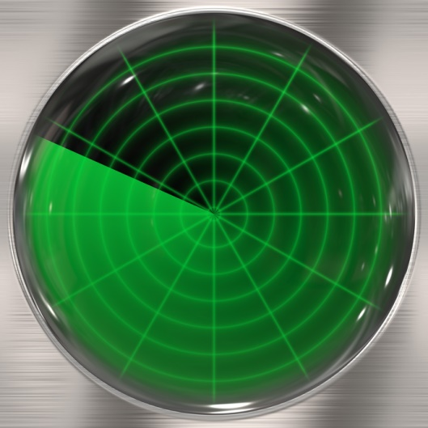
Practical Interest
Identify/classify/retrieve by rhythmic similarity
Music segmentation/summarization
Audio/video synchronization
And… source separation!

Slide 9
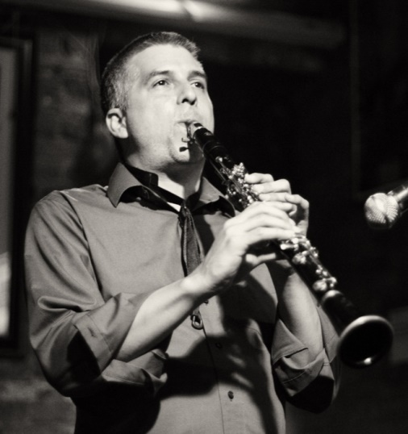
Intellectual Interest
“Music understanding” [Dannenberg, 1987]
Music perception
Music cognition
And… Fun!

Slide 10
Onset Detection (what?)
Identify the starting times of musical elements
E.g., notes, drum sounds, or any sudden change
See novelty curve [Foote, 2000]
Beginning of Another one bites the dust by Queen.

Slide 11
Onset Detection (how?)
Analyze amplitude (drums have high energy!)
Analyze other cues (e.g., spectrum, pitch, phase)
Analyze self-similarity (see similarity matrix)
All the note onsets
Beginning of Another one bites the dust by Queen.

Slide 12
Tempo Estimation (what?)
Identify periodic or quasi-periodic patterns
Identify some period of repetition
See beat spectrum [Foote et al., 2001]
Beginning of Another one bites the dust by Queen.

Slide 13
Tempo Estimation (how?)
Analyze periodicities using the autocorrelation
Compare the onsets with a bank of comb filters
Use the Short-Time Fourier Transform (STFT)
Tempo at the kick-snare level
Beginning of Another one bites the dust by Queen.

Slide 14
Beat Tracking (what?)
Identify the beat times
Identify the times to which we tap our feet
See (also) beat spectrum [Foote et al., 2001]
Beginning of Another one bites the dust by Queen.

Slide 15
Beat Tracking (how?)
Find optimal beat times given onsets and tempo
Use Dynamic Programming [Ellis, 2007]
Use Multi-Agent System [Goto, 2001]
Beats at the kick-snare level
Beginning of Another one bites the dust by Queen.

Slide 16
Higher-level Structures (what?)
Rhythm, meter, etc.
“Music understanding”
See (again) beat spectrum and similarity matrix
Beginning of Another one bites the dust by Queen.

Slide 17
Higher-level Structures (how?)
Extract onsets, tempo, beat
Use/assume additional knowledge
E.g., how many beats per measure? Etc.
Hi-hat level
Beat level
Kick level
Beginning of Another one bites the dust by Queen.

Slide 18
State-of-the-Art
Some interesting links
Dannenberg’s articles on beat tracking: http://www.cs.cmu.edu/~rbd/bib-beattrack.html
Goto’s work on beat tracking: http://staff.aist.go.jp/m.goto/PROJ/bts.html
Ellis’ Matlab codes for tempo estimation and beat tracking: http://labrosa.ee.columbia.edu/projects/beattrack/
MIREX’s annual evaluation campaign for Music Information Retrieval (MIR) algorithms, including tasks such as onset detection, tempo extraction, and beat tracking: http://www.music-ir.org/mirex/wiki/MIREX_HOME

Slide 19
The Autocorrelation Function
Definition
Cross-correlation of a signal with itself = measure of self-similarity as a function of the time lag
Beginning of Another one bites the dust by Queen.
Autocorrelation plot.

Slide 20
The Autocorrelation Function
Application
Identify repeating patterns
Identify periodicities
Beginning of Another one bites the dust by Queen.
Periodicity
of about 4 s
Autocorrelation plot.

Slide 21
The Autocorrelation Function
Application
Identify repeating patterns
Identify periodicities
Periodic signal + random signal.
Autocorrelation plot.

Slide 22
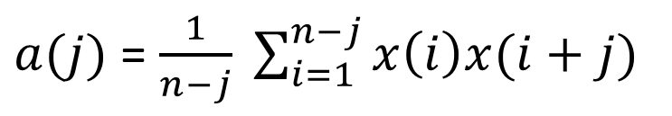
The Autocorrelation Function
Calculation
$a(j)$ = $\frac{1}{n−j} \sum_{i=1}^{n−j}{x\left(i\right)x(i+j)}$

Slide 23



The Autocorrelation Function
Calculation
$a(j)$ = $\frac{1}{n−j} \sum_{i=1}^{n−j}{x\left(i\right)x(i+j)}$
samples
1 | 2 | 3 | 4
$$x\left(i\right)=$$
1 | 3 | 1 | 3
$$x\left(i+0\right)=$$
1 | 3 | 1 | 3
$$a\left(j\right)=$$
0 | 1 | 2 | 3
lags

Slide 24
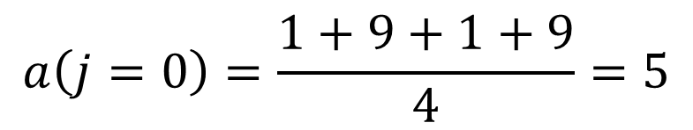
The Autocorrelation Function
Calculation
$a(j)$ = $\frac{1}{n−j} \sum_{i=1}^{n−j}{x\left(i\right)x(i+j)}$
samples
1 | 2 | 3 | 4
$$x\left(i\right)=$$
1 | 3 | 1 | 3
$$x\left(i+0\right)=$$
1 | 3 | 1 | 3
$$a\left(j=0\right)=\frac{1+9+1+9}{4}=5$$
$$a\left(j\right)=$$
5
0 | 1 | 2 | 3
lags

Slide 25

The Autocorrelation Function
Calculation
$a(j)$ = $\frac{1}{n−j} \sum_{i=1}^{n−j}{x\left(i\right)x(i+j)}$
samples
1 | 2 | 3 | 4
$$x\left(i\right)=$$
1 | 3 | 1 | 3
$$x\left(i+1\right)=$$
1 | 3 | 1 | 3
$$a\left(j\right)=$$
5
0 | 1 | 2 | 3
lags

Slide 26
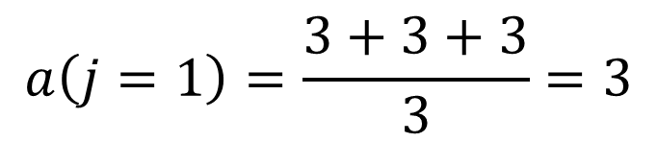
The Autocorrelation Function
Calculation
$a(j)$ = $\frac{1}{n−j} \sum_{i=1}^{n−j}{x\left(i\right)x(i+j)}$
samples
1 | 2 | 3 | 4
$$x\left(i\right)=$$
1 | 3 | 1 | 3
$$x\left(i+1\right)=$$
1 | 3 | 1 | 3
$$a\left(j=1\right)=\frac{3+3+3}{3}=3$$
$$a\left(j\right)=$$
5 | 3
0 | 1 | 2 | 3
lags

Slide 27

The Autocorrelation Function
Calculation
$a(j)$ = $\frac{1}{n−j} \sum_{i=1}^{n−j}{x\left(i\right)x(i+j)}$
samples
1 | 2 | 3 | 4
$$x\left(i\right)=$$
1 | 3 | 1 | 3
$$x\left(i+2\right)=$$
1 | 3 | 1 | 3
$$a\left(j\right)=$$
5 | 3
0 | 1 | 2 | 3
lags

Slide 28
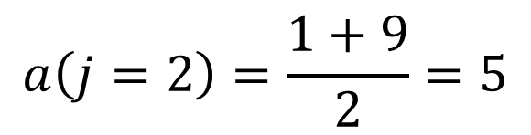
The Autocorrelation Function
Calculation
$a(j)$ = $\frac{1}{n−j} \sum_{i=1}^{n−j}{x\left(i\right)x(i+j)}$
samples
1 | 2 | 3 | 4
$$x\left(i\right)=$$
1 | 3 | 1 | 3
$$x\left(i+2\right)=$$
1 | 3 | 1 | 3
$$a\left(j=2\right)=\frac{1+9}{2}=5$$
$$a\left(j\right)=$$
5 | 3 | 5
0 | 1 | 2 | 3
lags

Slide 29

The Autocorrelation Function
Calculation
$a(j)$ = $\frac{1}{n−j} \sum_{i=1}^{n−j}{x\left(i\right)x(i+j)}$
samples
1 | 2 | 3 | 4
$$x\left(i\right)=$$
1 | 3 | 1 | 3
$$x\left(i+3\right)=$$
1 | 3 | 1 | 3
$$a\left(j\right)=$$
5 | 3 | 5
0 | 1 | 2 | 3
lags

Slide 30
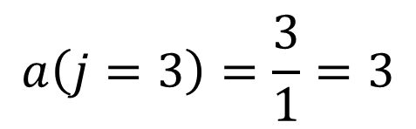
The Autocorrelation Function
Calculation
$a(j)$ = $\frac{1}{n−j} \sum_{i=1}^{n−j}{x\left(i\right)x(i+j)}$
samples
1 | 2 | 3 | 4
$$x\left(i\right)=$$
1 | 3 | 1 | 3
$$x\left(i+3\right)=$$
1 | 3 | 1 | 3
$$a\left(j=3\right)=\frac{3}{1}=3$$
$$a\left(j\right)=$$
5 | 3 | 5 | 3
0 | 1 | 2 | 3
lags

Slide 31
The Autocorrelation Function
Calculation
$a(j)$ = $\frac{1}{n−j} \sum_{i=1}^{n−j}{x\left(i\right)x(i+j)}$
samples
1 | 2 | 3 | 4
$$x\left(i\right)=$$
1 | 3 | 1 | 3
$$a\left(j\right)=$$
5 | 3 | 5 | 3
0 | 1 | 2 | 3
lags

Slide 32
The Autocorrelation Function
Calculation
$a(j)$ = $\frac{1}{n−j} \sum_{i=1}^{n−j}{x\left(i\right)x(i+j)}$
Periodic sequence
of 2 samples
Lag 0 = similarity
with itself
Period of
2 samples

Slide 33
The Autocorrelation Function
Notes
The autocorrelation generally starts at lag 0 = similarity of the signal with itself
Wiener-Khinchin Theorem: Power Spectral Density = Fourier Transform of autocorrelation
Autocorrelation plot.

Slide 34
Foote’s Beat Spectrum
Definition
Using the autocorrelation function, we can derive the beat spectrum [Foote et al., 2001]
Beginning of Another one bites the dust by Queen.
Beat Spectrum.

Slide 35
Foote’s Beat Spectrum
Application
The beat spectrum reveals the hierarchically periodically repeating structure
Beginning of Another one bites the dust by Queen.
Periodicity at
the measure level
Periodicity at
the kick level
Periodicity at
the beat level
Beat Spectrum.

Slide 36
Foote’s Beat Spectrum
Calculation
Compute the power spectrogram from the audio using the STFT (square of magnitude spectrogram)

Slide 37
Foote’s Beat Spectrum
Calculation
Compute the autocorrelation of the rows (i.e., the frequency channels) of the spectrogram

Slide 38
Foote’s Beat Spectrum
Calculation
Compute the mean of the autocorrelations (of the rows)

Slide 39
Foote’s Beat Spectrum
Notes
The first highest peak in the beat spectrum does not always correspond to the repeating period!
The beat spectrum does not indicate where the beats are or when a measure starts!
This is how you find the period…
This is not
the period
Beat Spectrum.

Slide 40
Foote’s Beat Spectrum
Notes
The beat spectrum can also be calculated using the similarity matrix [Foote et al., 2001]
A beat spectrogram can also be calculated using successive beat spectra [Foote et al., 2001]
Beat Spectrogram.

Slide 41
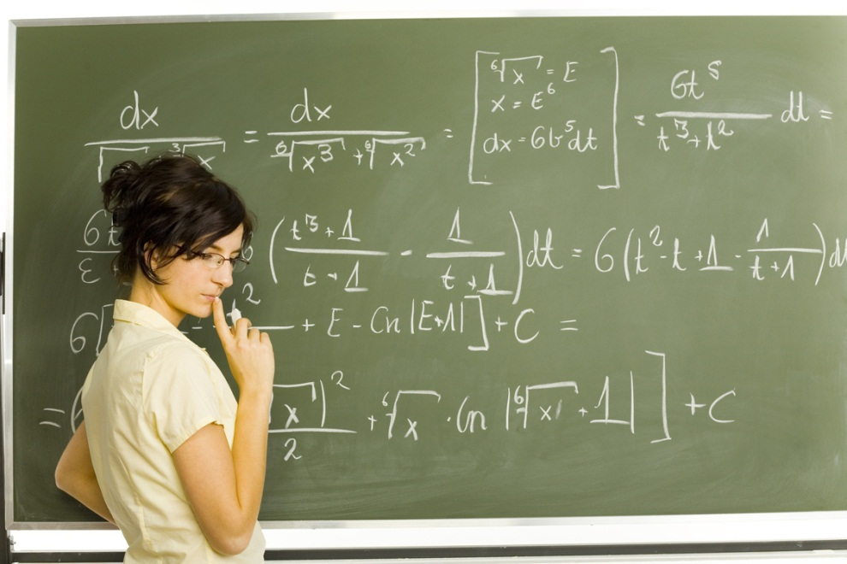
Foote’s Beat Spectrum
Question
Can we use the beat spectrum for source separation?...
To be continued…

Slide 42
References
R. B. Dannenberg, “Music Understanding by Computer,” 1987/1988 Computer Science Research Review, Carnegie Mellon School of Computer Science, pp. 19-28, 1987.
J. Foote, “Visualizing Music and Audio using Self-Similarity,” in 7th ACM International Conference on Multimedia (Part 1), Orlando, FL, USA, pp. 77-80, October 30-November 05, 1999.
J. Foote, “Automatic Audio Segmentation using a Measure of Audio Novelty,” in IEEE International Conference on Multimedia and Expo, New York, NY, USA, vol.1, pp. 452-455, July 30-August 02, 2000.
J. Foote and S. Uchihashi, “The Beat Spectrum: A New Approach to Rhythm Analysis,” in IEEE International Conference on Multimedia and Expo, Tokyo, Japan, pp. 881-884, August 22-25, 2001.
M. Goto, “An Audio-based Real-time Beat Tracking System for Music With or Without Drum-sounds,” Journal of New Music Research, vol. 30, no. 2, pp. 159-171, 2001.
D. P. W. Ellis, “Beat Tracking by Dynamic Programming,” Journal of New Music Research, vol. 36, no. 1, pp. 51-60, 2007.
M. Müller, D. P. W. Ellis, A. Klapuri, and G. Richard, “Signal Processing for Music Analysis,” IEEE Journal of Selected Topics in Signal Processing, vol. 5, no. 6, pp. 1088-1110, October 2011.
Wikipedia, “Rhythm,” http://en.wikipedia.org/wiki/Rhythm, 2012.
Wikipedia, “Meter,” http://en.wikipedia.org/wiki/Metre_(music), 2012.

Slide 43
The Similarity Matrix
Definition
Matrix where each point measures the similarity between any two elements of a given sequence
Similarity matrix.

Slide 44
The Similarity Matrix
Application
Visualize time structure [Foote, 1999]
Identify repeating/similar patterns
Similarity matrix.
Similarity between
the times at
2 s and 10 s.
Very
similar
Region of high
self-similarity
around 3 s.
Region around 3 s
repeating around
8 s, 12 s, and 17 s.
Very
dissimilar

Slide 45
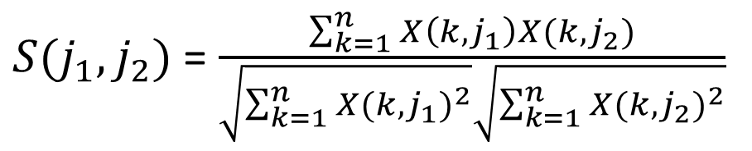
The Similarity Matrix
Calculation
The similarity matrix S of X is basically the matrix multiplication between transposed X and X, after (generally) normalization of the columns of X
$S(j_{1},j_{2})$ = $\frac{\sum_{k=1}^{n}{X\left(k,j_{1}\right)X(k,j_{2})}}{\sqrt{\sum_{k=1}^{n}{{X(k,j_{1})}^{2}}}\sqrt{\sum_{k=1}^{n}{{X(k,j_{2})}^{2}}}}$

Slide 46
The Similarity Matrix
Calculation
Compute the magnitude spectrogram from the audio using the STFT

Slide 47





The Similarity Matrix
Calculation
Normalize the columns of the spectrogram by dividing them by their Euclidean norm
$$X$$
$$\hat{X}$$
$$X_{j}$$
$${\hat{X}}_{j}$$
${\hat{X}}_{j}(i)=$ $\frac{X_{j}(i)}{\sqrt{\sum_{k=1}^{n}{{X_{j}(k)}^{2}}}}$

Slide 48




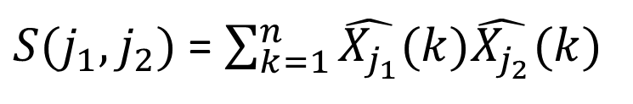


The Similarity Matrix
Calculation
Compute the dot product between any two pairs of columns and save them in the similarity matrix
$$\hat{X}$$
$$S$$
$${\hat{X}}_{j_{1}}$$
$${\hat{X}}_{j_{2}}$$
$$j_{1}$$
$S(j_{1},j_{2})$ = $\sum_{k=1}^{n}{\hat{X_{j_{1}}}(k)\hat{X_{j_{2}}}(k)}$
$$j_{2}$$

Slide 49
The Similarity Matrix
Notes
The similarity matrix can also be built from other features (e.g., MFCCs, chromagram, pitch contour)
The similarity matrix can also be built using other measures (e.g., Euclidean distance)

